Slide 1


KRAKEN QGIS PLUGIN • USER MANUAL
Best Cell Analyzer
Automated dominant serving cell identification and spatial mesh engine for targeted RAN optimization and coverage troubleshooting in QGIS.
RF Score Engine
Batch Input
Interactive Vector Mesh
Distance & 65° antenna attenuation model
Direct clipboard paste for multiple drop points
Auto-generated styled line & point layers
Kraken © 2026 | akanipatra@gmail.com

Slide 2
CORE ENGINE • 3GPP ANTENNA MODEL
RF Effective Distance & Scoring
How Kraken identifies dominant serving cells beyond simple geographic distance
01
Angle Deviation (θ)
Calculates angle difference (0°-180°) between cell azimuth and drop point bearing.
2x Buffer Auto-Expand
SPATIAL RADIUS FALLBACK
Automatically doubles initial search radius if zero candidates are found in the initial bounding box.
02
3GPP Antenna Attenuation
Applies standard model: Attn(dB) = min(20, 12 * (θ / 65)²).
C++ Bounding Box
03
Effective Distance Score
GEOGRAPHIC & PROJECTED CRS
Utilizes spatial index filtering directly in QGIS C++ engine for instant querying.
Ranks best servers using weighted RF impact: EffDist = Dist * 10^(Attn / 35).
Kraken © 2026 | akanipatra@gmail.com

Slide 3

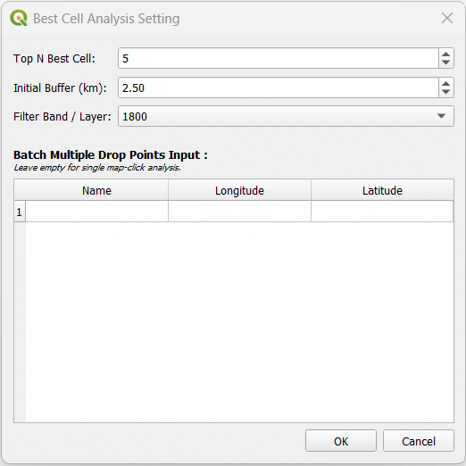
WORKFLOW PHASE 01 • ANALYSIS SETUP
Configuration & Batch Input
Configure ranking criteria and single or batch coordinate drop points
1. Top N Best Cell
Specify maximum serving candidate cells to evaluate (Default: 5, Range: 1-50).
2. Initial Buffer (km)
Define initial spatial search radius in kilometers (Default: 2.5 km).
3. Filter Band / Layer
Select specific frequency layer (e.g., 1800, 2100) or evaluate across ALL BANDS.
4. Excel Copy-Paste Batch Table
Paste multi-row Excel data directly (Name, Longitude, Latitude). Leaves empty for single-click canvas mode.
Kraken © 2026 | akanipatra@gmail.com

Slide 4
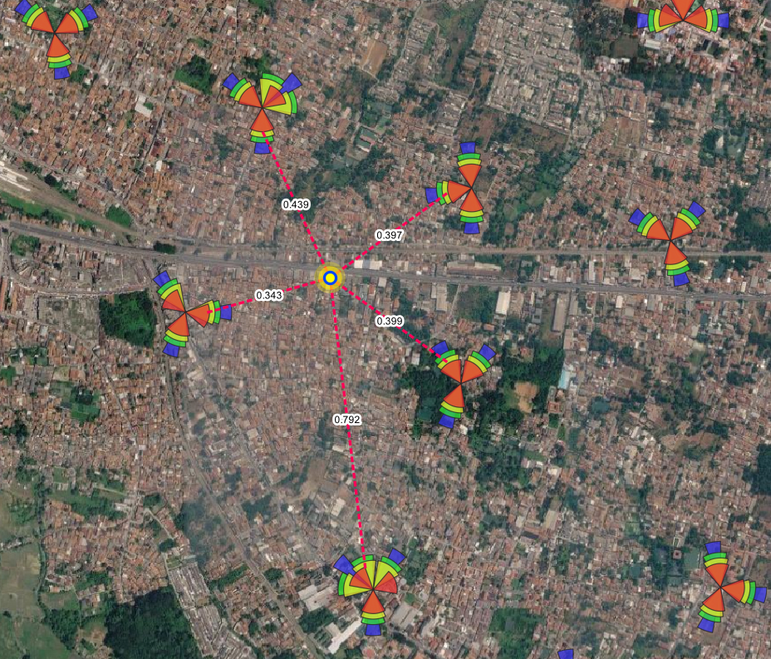
WORKFLOW PHASE 02 • SPATIAL OUTPUT
Map Mesh & Drop Point Rendering
Automatic styling and multi-layer vector generation on QGIS canvas
Layer 1: Best_Cell_Mesh
LineString
Red dotted line connection (#FF0055) between drop point and candidate cell centroids. Features automatic distance labels in kilometers.
Layer 2: Best_Cell_Drop_Point
Point Layer
Multi-ring glowing yellow target marker (#FFFF00) highlighting analysis location with high precision.
Rich Vector Attribute Table
Rank • Tower_ID • Sector • Cell_Name • Band • PRB_Util • Throughput • TA • TA90 • Dist_km • Azimuth • Bearing • Angle_Dev • Attn_dB • Eff_Dist_Score
Kraken © 2026 | akanipatra@gmail.com

Slide 5
SUMMARY & BEST PRACTICES
Execution Modes & Operational Tips
Maximize workflow efficiency with dual analysis modes and proper setup
Map-Click Mode
Batch Excel Mode
Dynamic Column Mapping
Leave batch table empty. Click OK to activate Crosshair map tool, then click anywhere on canvas for instant single-point analysis.
Paste hundreds of coordinates directly from Excel. Generates unified batch mesh and drop point layers in a single pass.
Ensure field mappings (Azimuth, Band, Sector, TA, PRB, Throughput) are properly set in Kraken Main Settings prior to running.
Automatic Canvas Cleanup
AUTO REFRESH
Re-running analysis automatically refreshes and updates existing Best_Cell_Mesh layers without canvas clutter.
Kraken © 2026 | akanipatra@gmail.com

